Slide 1



WUZZUF Analytics ( final project)
View in Power BI
Last data refresh:
5/22/2025 4:31:21 PM UTC
Downloaded at:
5/22/2025 4:37:43 PM UTC

Slide 2
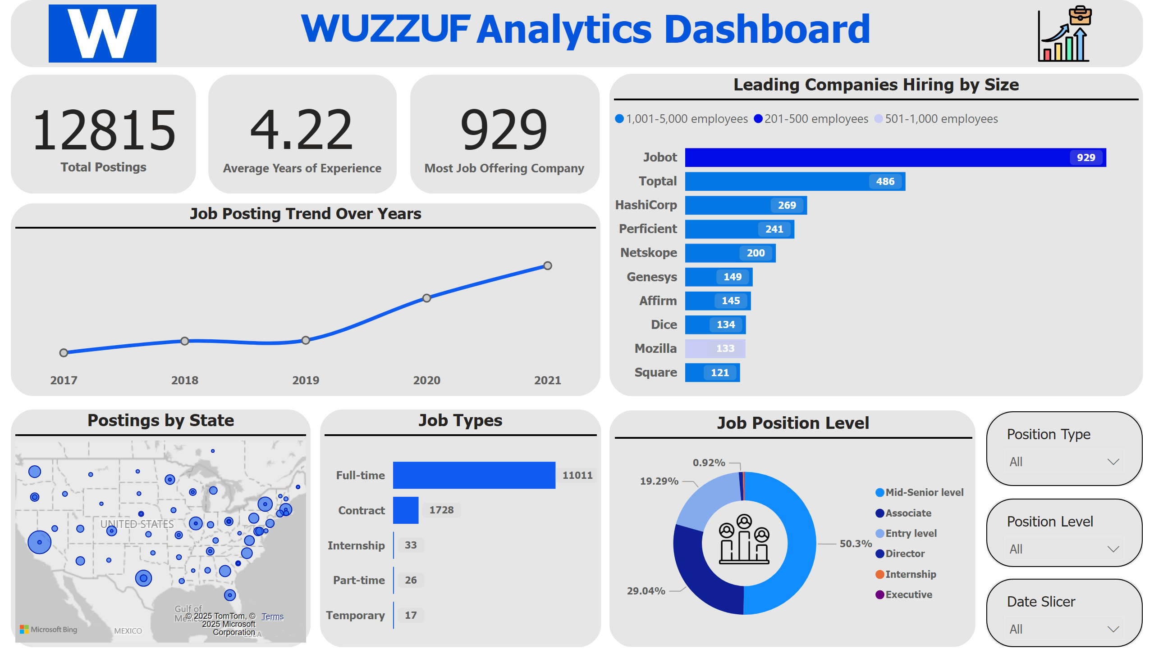
Overview Dashboard
Notes:
card
No alt text provided
card
No alt text provided
card
No alt text provided
Leading Companies Hiring by Size
No alt text provided
Postings by State
No alt text provided
Job Position Level
No alt text provided
Job Types
No alt text provided
textbox
No alt text provided
slicer
No alt text provided
slicer
No alt text provided
slicer
No alt text provided
Job Posting Trend Over Years
No alt text provided
image
No alt text provided
image
No alt text provided
image
No alt text provided
shape
No alt text provided
shape
No alt text provided
shape
No alt text provided
shape
No alt text provided
shape
No alt text provided
shape
No alt text provided
shape
No alt text provided
shape
No alt text provided
shape
No alt text provided
shape
No alt text provided
shape
No alt text provided
shape
No alt text provided
image
No alt text provided

Slide 3
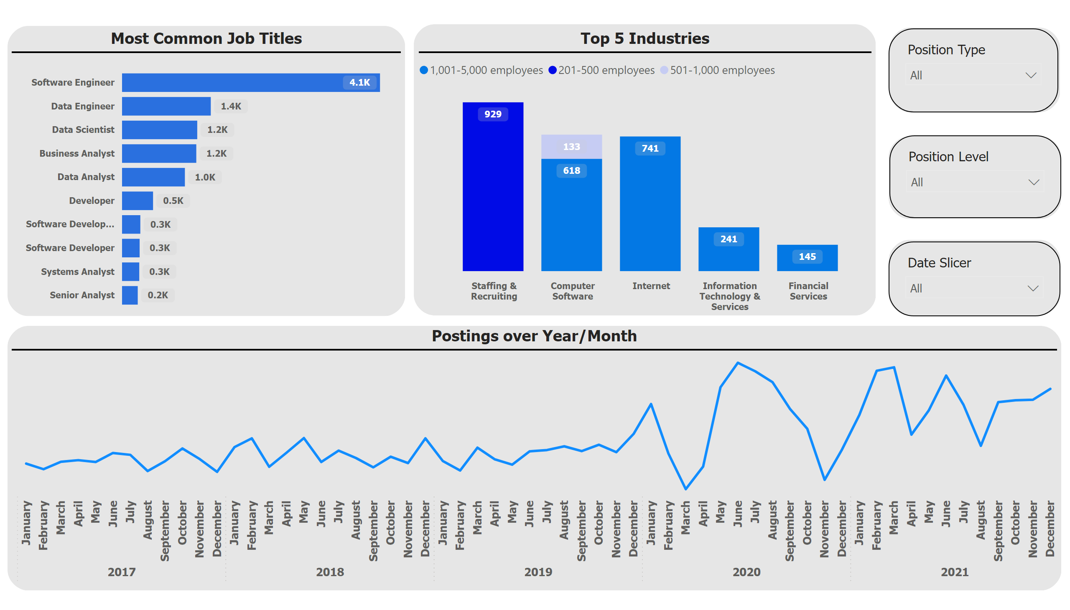
Wuzzuf postings trend
Notes:
Postings over Year/Month
No alt text provided
Top 5 Industries
No alt text provided
Most Common Job Titles
No alt text provided
slicer
No alt text provided
slicer
No alt text provided
slicer
No alt text provided
shape
No alt text provided
shape
No alt text provided
shape
No alt text provided
shape
No alt text provided
shape
No alt text provided
shape
No alt text provided

